Slide 1
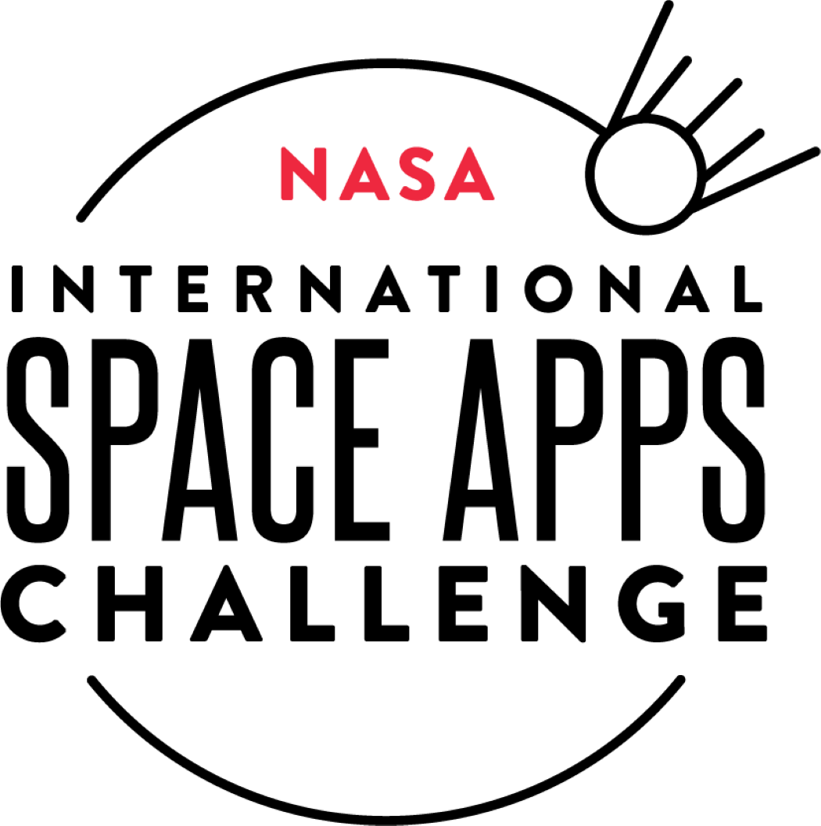

Biotic Inter-Operable Plant System
AGROTES DE L'ESPACE
AUTONOMOUS, SCALABLE SPACE PLANTATION PODS

Slide 2
- Problem Statement
- Overview
- How Our Solution is Different?
- Future Improvements
- Additional Information and Questions
- Submission Links
- Website
TABLE OF CONTENTS
Index
“THE SEEDERS”
The Team
Pranav Balaji
Srihari Sridhar
Daksh Raturi
Pradosh Sivaramkumar
Paridhi Agarwal
Abhinav Jella

Slide 3
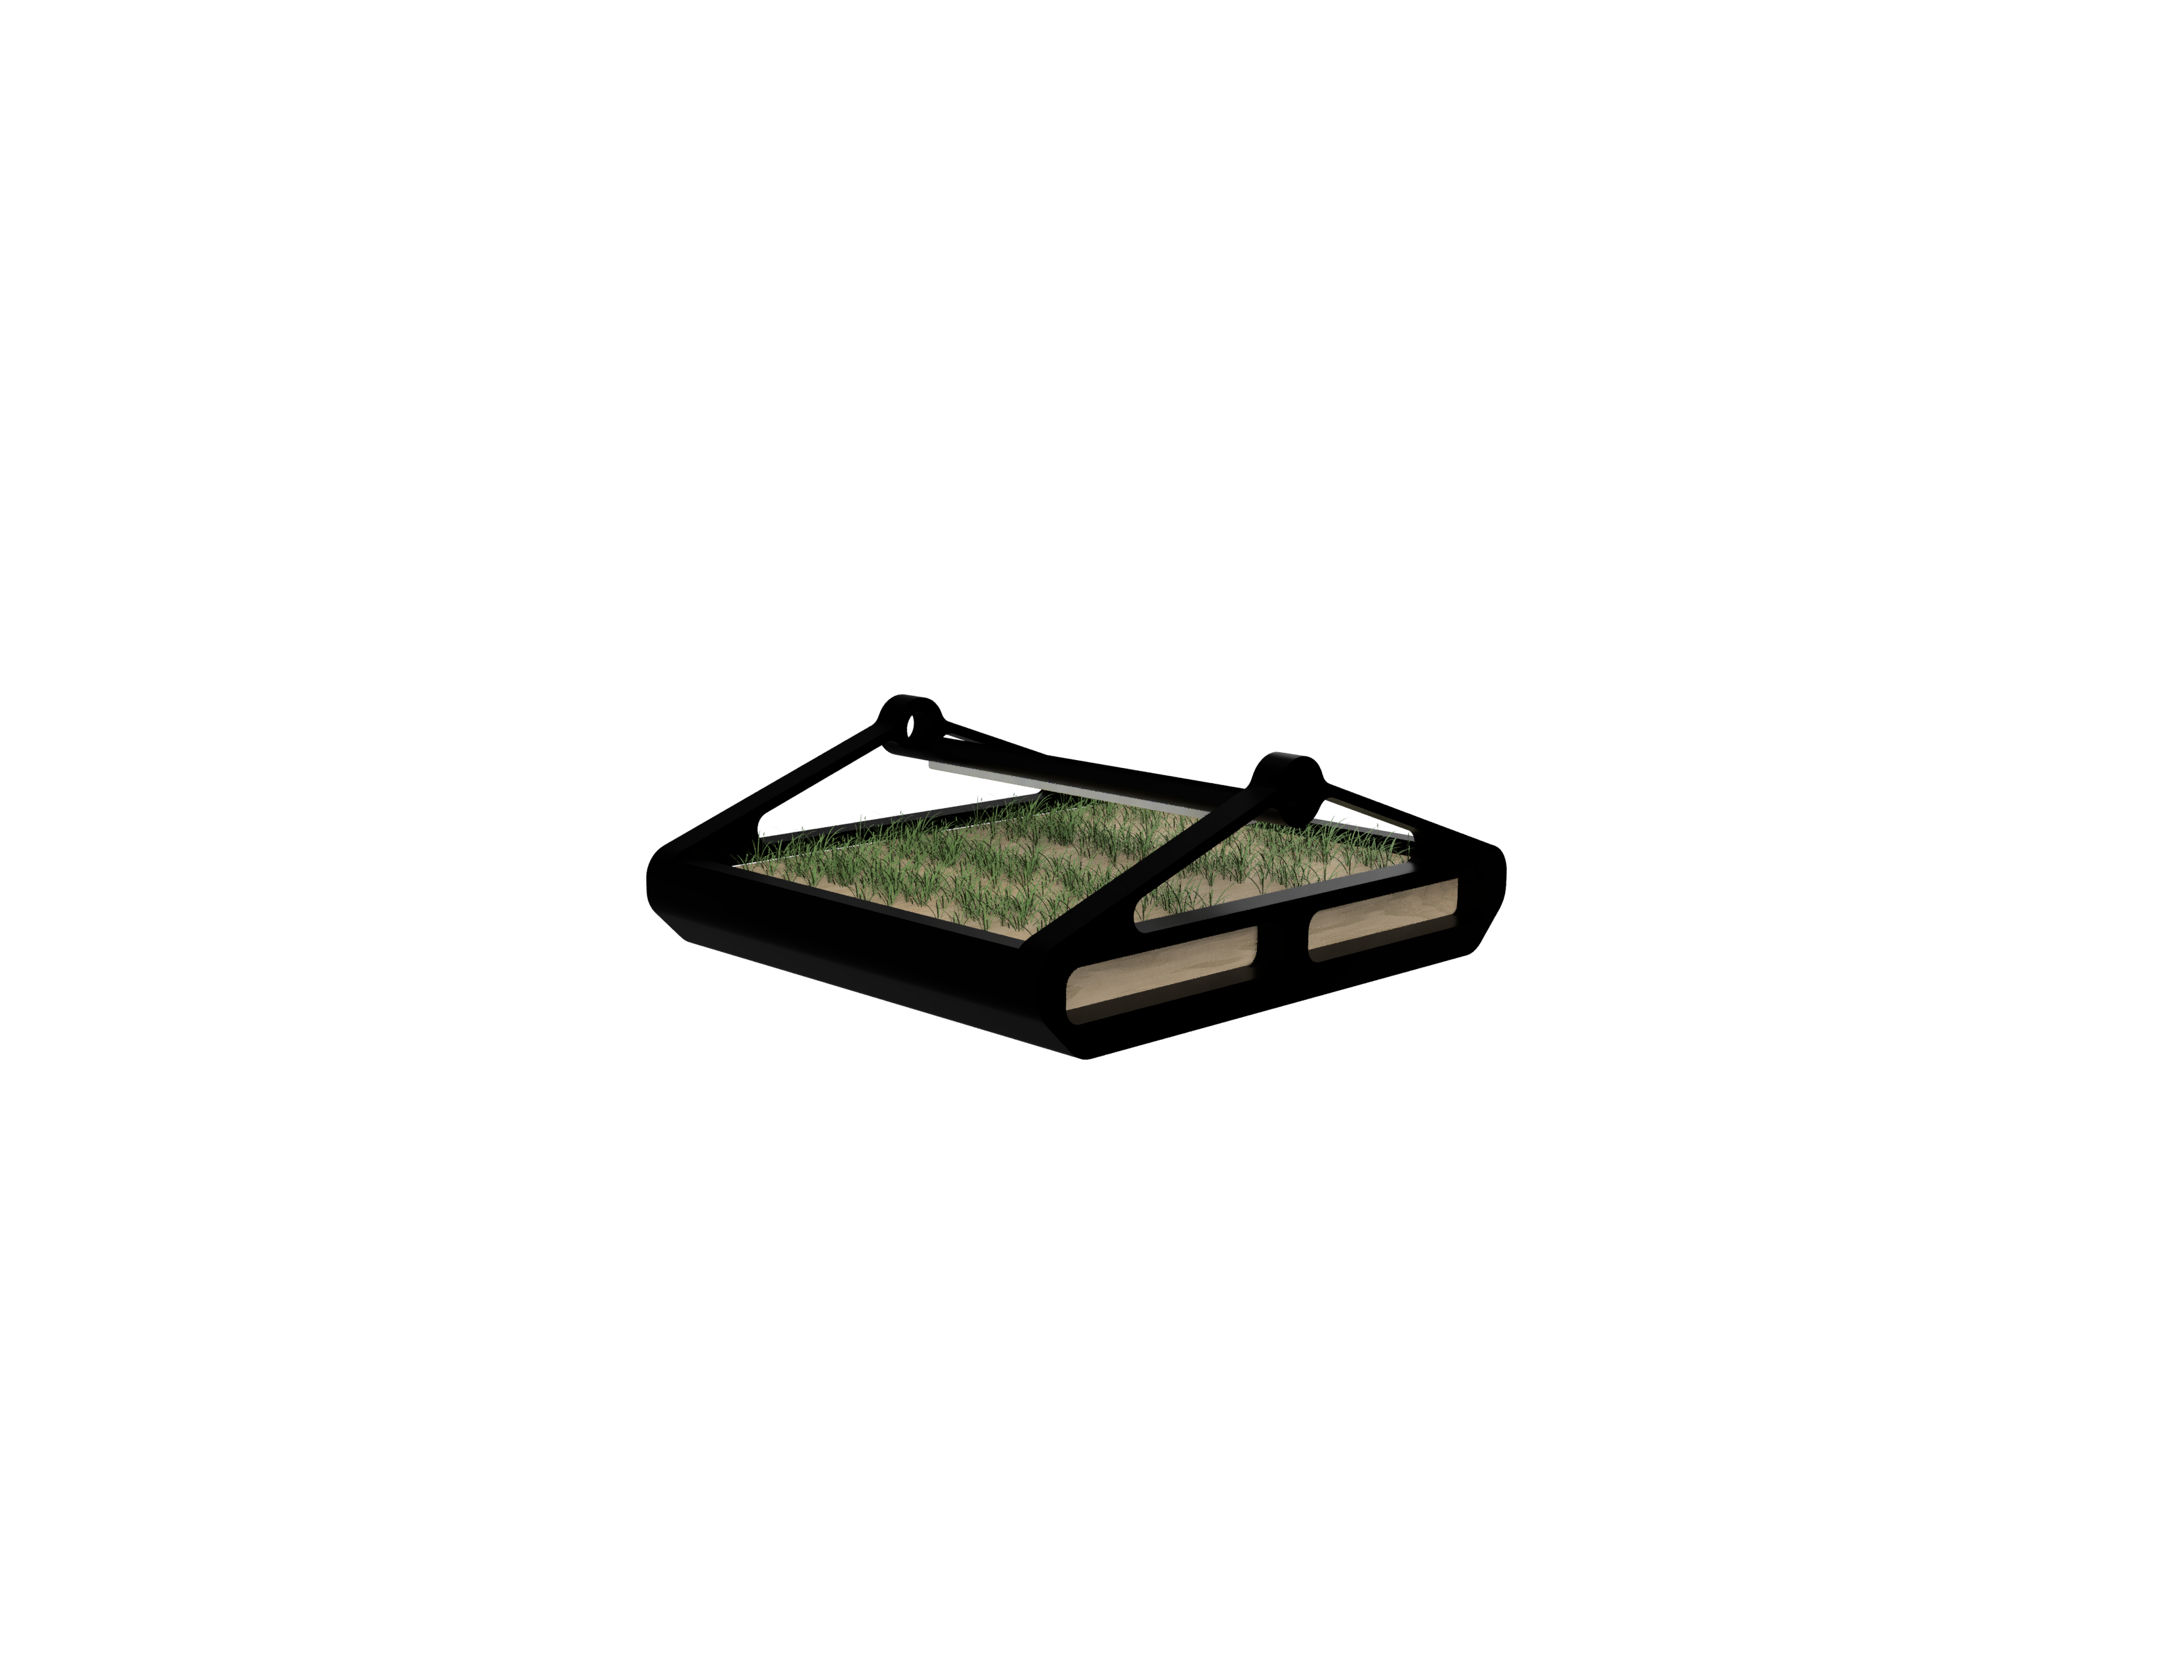
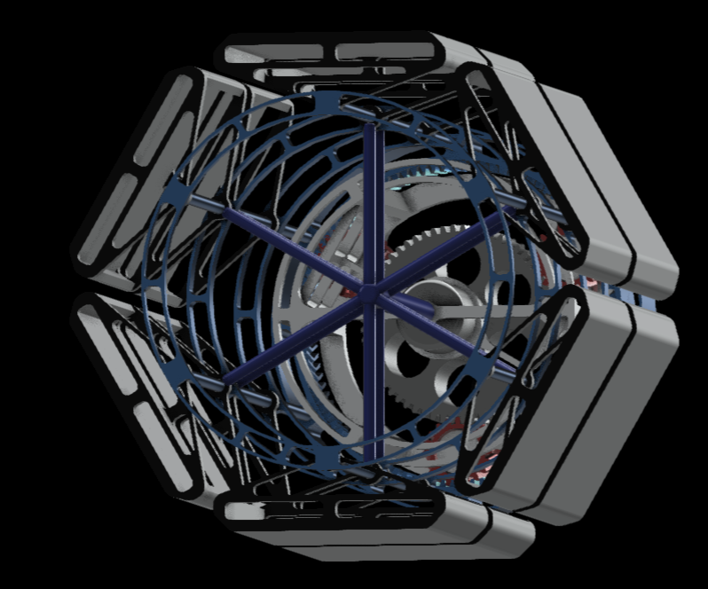
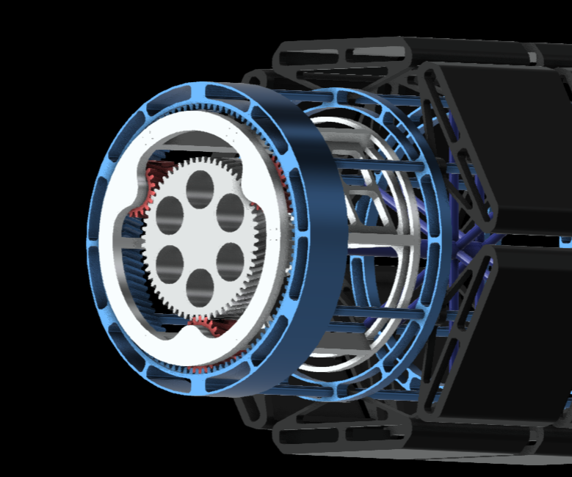
THE SOLUTION WE ADDRESS
Problem Statement
“Have seeds will travel”
THE SOLUTION WE PROPOSE
Overview
The BIOS - 1 is an advanced, scalable, autonomous, and self-sustaining space plantation pod system. Built for a team of six astronauts, BIOS - 1 can run on both, spacecrafts, and terrain. It employs the method of hydroponics with gravity-inducing rotation to grow plants and each plant growing “pod” is automatically monitored by our neural system, the CAPS (refer main presentation/ project report)

Slide 4
So, how is our solution different?
The BIOS-1 uses a maglev motor to rotate the inner module which produces artificial gravity radially outwards causing the pods to face inwards. This gravity is used to help the hydro drip system deliver water to the plants and to assist the roots in aligning themselves. The hydro drip system uses semi-permeable membranes along with a centrifugal pump and electronically controlled check valves to deliver water to the plants. The pods are on a free axle which allows them to easily align themselves upwards in the presence of microgravity on the surface of celestial bodies. The lights and sensors are placed on the axle which ensures that they are always facing the plant regardless of the pods' orientation. The BIOS-1 lighting system not only provides light to be used as a source of energy for photosynthesis but also for the process of photomorphogenesis which optimizes plant growth and other physiological processes by taking advantage of the adjustable spectrum LED grow lights and controlling the quantity, wavelength and duration of light a particular plant receives. We have an onboard computerized automated production system (CAPS) that controls all the processes of the BIOS-1 and records all the incoming data from various sensors which it runs through a neural network in order to make better future decisions.
THE SOLUTION WE PROPOSE
Future Improvements
Adopt an aggressive primary role in portable space food production
BIOS – 2 to be fully autonomous, reducing the already meagre human involvement to none
Adopting aeroponics for more efficient production
An in-built composting system
Reducing design complexity for more efficient mass-production
Reducing dimensions

Slide 5
Additional Information
What inspired your team to choose this challenge?
The solution we propose to this challenge gives humanity a chance to enter a whole new era of revolution in every aspect of our life and become a multi-planetary specie.
After we had the mentoring session their were some queries placed forwarded about our design by panel:, we have given a solution to all of them with the content we have on our previous slides but 1 question still remained and that was about heavy energy consumption when we are present in mars, for this problem the solution is very simple we won't be rotating the module in Martian surface as we only need rotation for Gravitropism and Mars already has enough gravitational force to ensure this. When we are on Martian surface, we only have to spend energy on maintaining the CAMPS
What problem does it solve?
It solves one of the biggest problem we have in long term human planned space exploration, which is the lack of fresh nutritious food.
What do people gain? Where is the opportunity?
This gives people new hope, and the opportunity limitless, endless.
What will your idea change?
Our idea changes long term space exploration completely and helps humanity become tier-2 civilization.
How did using data from one or more of the 10 space partner agencies make your solution possible?
We used a tonne of research articles from multiple space agencies including NASA and JAXA to develop our plantation pods. Articles on plantations on the International Space Station (ISS) and experiments there on hydroponics helped us a lot. Not only this, but articles from these agencies also motivated us to improve and innovate in our power divisions.

Slide 6
GitHub: https://github.com/deltaonealpha/bios
Simulation renders:
bios/mock4.jpg at main · deltaonealpha/bios (github.com)
bios/mock5.jpg at main · deltaonealpha/bios (github.com)
bios/mock6.jpg at main · deltaonealpha/bios (github.com)
bios/animationrender_3.mp4 at main · deltaonealpha/bios (github.com)
bios/animationrender_4.mp4 at main · deltaonealpha/bios (github.com)
Website link: https://agrotes.co/
Main presentation: Main.pptx - Microsoft PowerPoint Online (1drv.ms)
(https://1drv.ms/p/s!AipgaRoMhpk5lvYD57wEtQl-r-omAQ?e=OFOYug)
Project report: bios/projectreportfinal.pdf at main · deltaonealpha/bios (github.com)
A LOT OF THEM :P
Submission Links

Slide 7
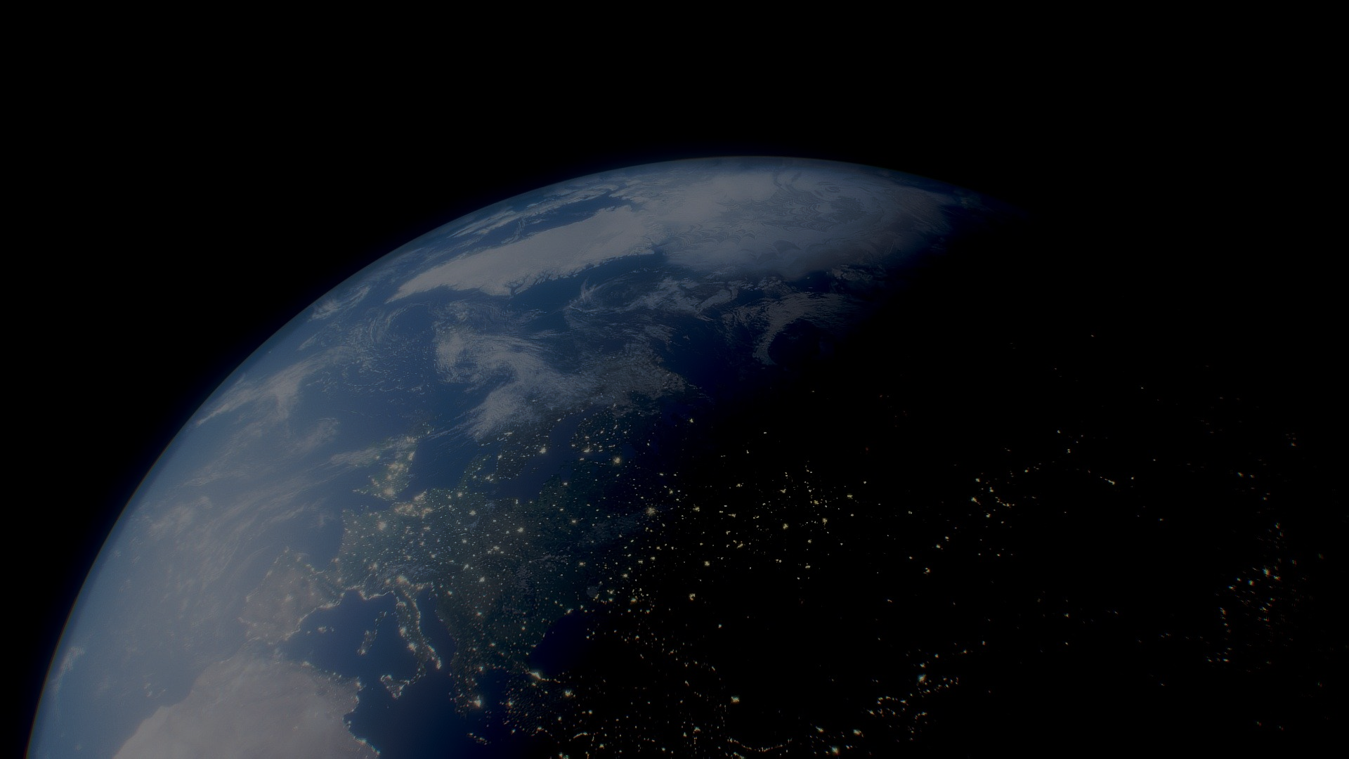
Please visit our website for more information, renders and updates.
https://agrotes.co

